Slide 1
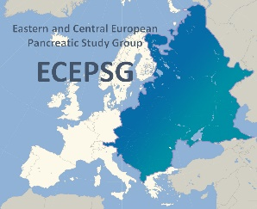
4th Conference of the Hungarian & 2nd Conference of the Eastern and Central European
Pancreatic Study Groups
Pancreatic Cancer Registry
Gábor Lakatos
09 november 2015
4th Conference of the Hungarian & 2nd Conference of the Eastern and Central European
Pancreatic Study Groups
Hungarian Pancreatic Study Group – Magyar Hasnyálmirigy Munkacsoport

Slide 2
Pancreatic cancer registry
Introduction
Pancreatic cancer remains a major health problem
Incidence
-Worldwide (2008)
new cases: 279 000
deaths: 266 000
- Hungary (2010):
new cases: 2373
deaths: 1837
Prognosis - unfavourable
1-year survival: 19%
5-year survival: 0,4-4%
Hungarian Pancreatic Study Group – Magyar Hasnyálmirigy Munkacsoport

Slide 3
Pancreatic cancer registry
Introduction
Central Europe – limited information
Worse prognosis compared to western countries
Increasing incidence and mortality (1.)
(Romania, Albania, Croatia, Serbia)
Possible explanation:
Differences:
the use and access of diagnostic tools and treatment modalities
changes in the incidence of risk factors (for example smoking)
(1.) Hariharan D et al
Hungarian Pancreatic Study Group – Magyar Hasnyálmirigy Munkacsoport

Slide 4
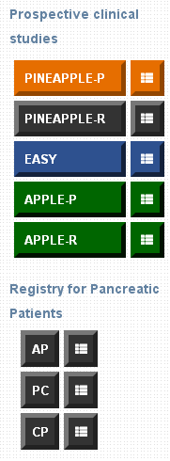
Pancreatic cancer registry
Introduction
Registry for Pancreatic Patients (RPP)
Est.: 2012
Web-based electronic data collection method
1600 patients, more than 1300 blood samples in the Biobank.
34 Hungarian centers
23 centers from abroad
Pancreatic Cancer Registry
Aim:
to prospectively collect and analyze data of pancreatic cancer in the
Hungarian population:
- Epidemiology, Risk factors, Diagnosis, Staging, Treatment, Survival
to collect blood samples for further research projects
Hungarian Pancreatic Study Group – Magyar Hasnyálmirigy Munkacsoport

Slide 5
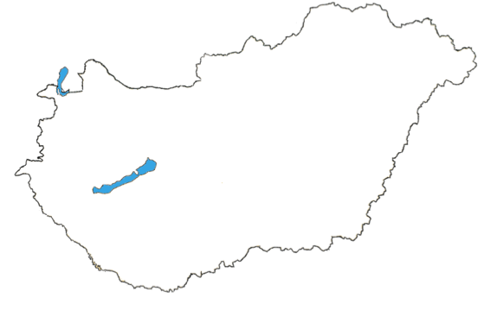
Pancreatic cancer registry
Pancreatic cancer. Hungarian cohort 2012-2014
Hungarian cohort for PC
Study period: 2012-2014
Centers: 14 (Hungary)
Patients: 354
Data are going to be published
! What we have learned:
Need to improve the quality of data collection
Need to extend the database to other Central and Eastern European countries.
Hungarian Pancreatic Study Group – Magyar Hasnyálmirigy Munkacsoport

Slide 6
Pancreatic cancer registry
Renewed registry for pancreatic cancer
2015 – the registry for pancreatic cancer has been completely renewed
Main changes:
The content of the questionnaire was fully updated
- possibility of more detailed data collection
The registry is available in two languages -
- Hungarian
- English
International data collection is now possible.
Hungarian Pancreatic Study Group – Magyar Hasnyálmirigy Munkacsoport

Slide 7
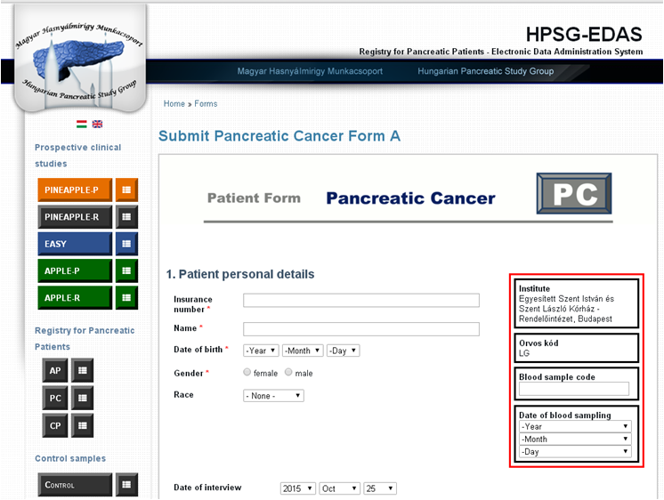
Pancreatic cancer registry
Renewed registry for pancreatic cancer
Pancreatic cancer registry – CONTENT
Patient personal details
Details from the medical history
Symptoms and signs
Patient related data
Tumor-related data
Oncological therapy
Supportive treatment
Concent form is available on the webpage
Data recording
Blood sampling
Hungarian Pancreatic Study Group – Magyar Hasnyálmirigy Munkacsoport

Slide 8
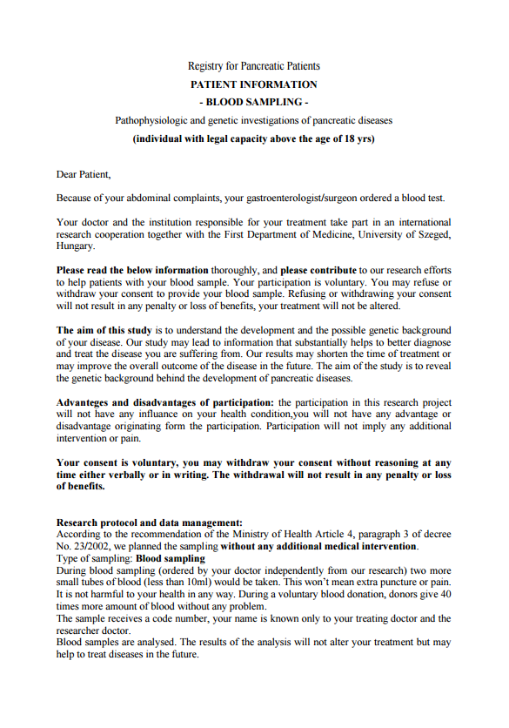
Pancreatic cancer registry
Renewed registry for pancreatic cancer
Pancreatic cancer registry – CONTENT
Patient personal details
Details from the medical history
Symptoms and signs
Patient related data
Tumor-related data
Oncological therapy
Supportive treatment
Concent form is available on the webpage
Data recording
Blood sampling
Hungarian Pancreatic Study Group – Magyar Hasnyálmirigy Munkacsoport

Slide 9
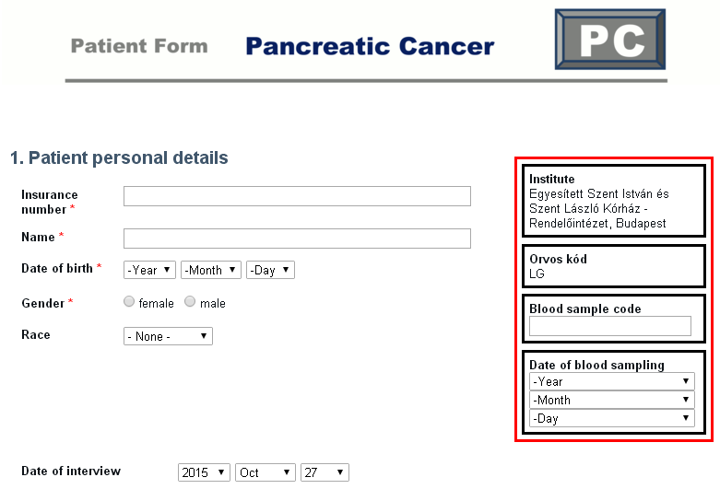
Pancreatic cancer registry
registry for pancreatic cancer - Content
HPSG2015
1. Patient personal details
Hungarian Pancreatic Study Group – Magyar Hasnyálmirigy Munkacsoport

Slide 10
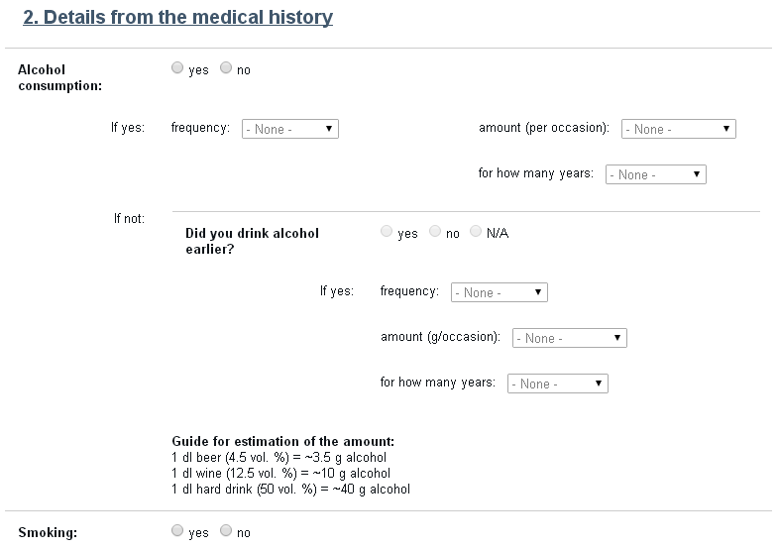
Pancreatic cancer registry
registry for pancreatic cancer - Content
2. Details from the medical history
Alcohol consumption
Smoking
Drug abuse
History of infectious disease
Diabetes mellitus
Lipid metabolism disorder
Familial pancreatic disease
Medication taken
Diet
Weight/height
BMI
Hungarian Pancreatic Study Group – Magyar Hasnyálmirigy Munkacsoport

Slide 11
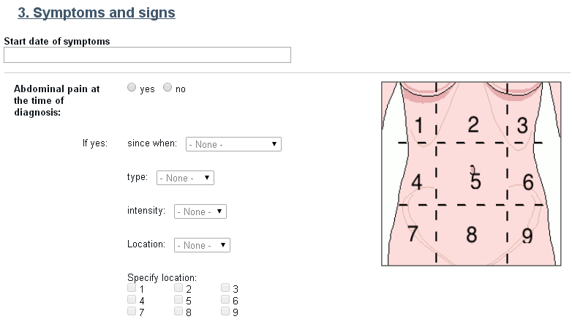
Pancreatic cancer registry
registry for pancreatic cancer - Content
3. Symptoms and signs
Abdominal pain
Nausea
Vomiting
Fever
Loss of appetite
Weight loss
Jaundice
Hungarian Pancreatic Study Group – Magyar Hasnyálmirigy Munkacsoport

Slide 12
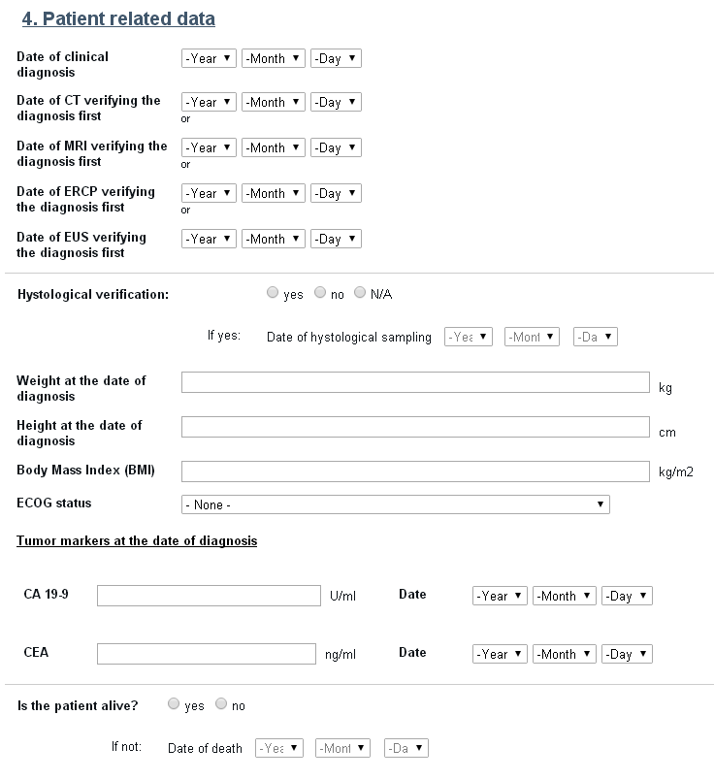
Pancreatic cancer registry
registry for pancreatic cancer - Content
4. Patient related data
Diagnosis
clinical
histological
Survival status
(Overall survival time)
ECOG PS status
Tumor markers:
CA 19-9, CEA
-
Hungarian Pancreatic Study Group – Magyar Hasnyálmirigy Munkacsoport

Slide 13
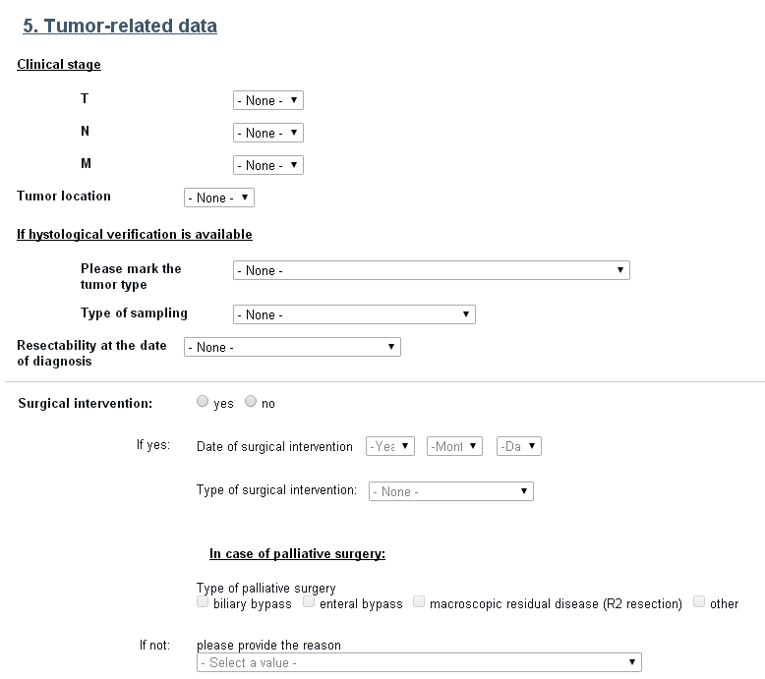
Pancreatic cancer registry
registry for pancreatic cancer - Content
5. Tumor related data
Staging
clinical
pathological
- Surgical treatment
resectability
type of surgical intervention
Endoscopic treatment
Radiological intervention
Hungarian Pancreatic Study Group – Magyar Hasnyálmirigy Munkacsoport

Slide 14
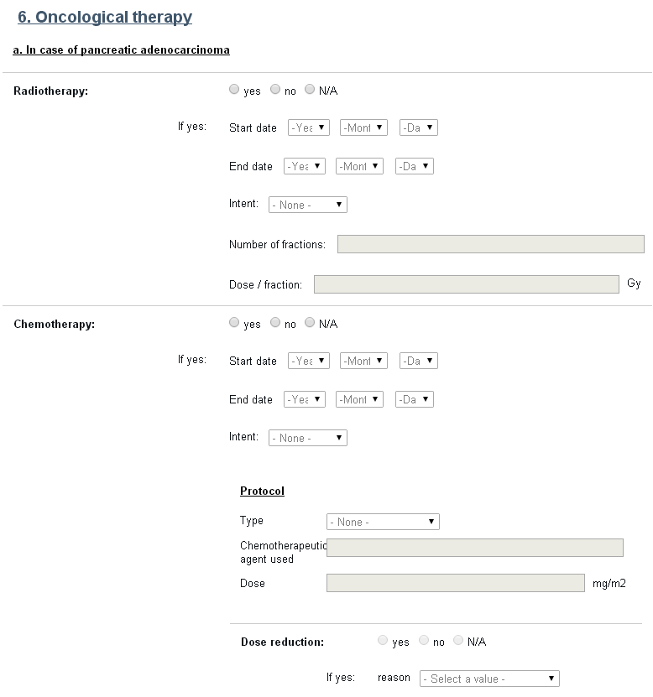
Pancreatic cancer registry
registry for pancreatic cancer - Content
6. Oncological therapy
Chemotherapy
Radiotherapy
Molecular targeted agents
Somatostatin analogue
Peptid receptor radionuclide Tx.
Progression free survival
Best response
Hungarian Pancreatic Study Group – Magyar Hasnyálmirigy Munkacsoport

Slide 15
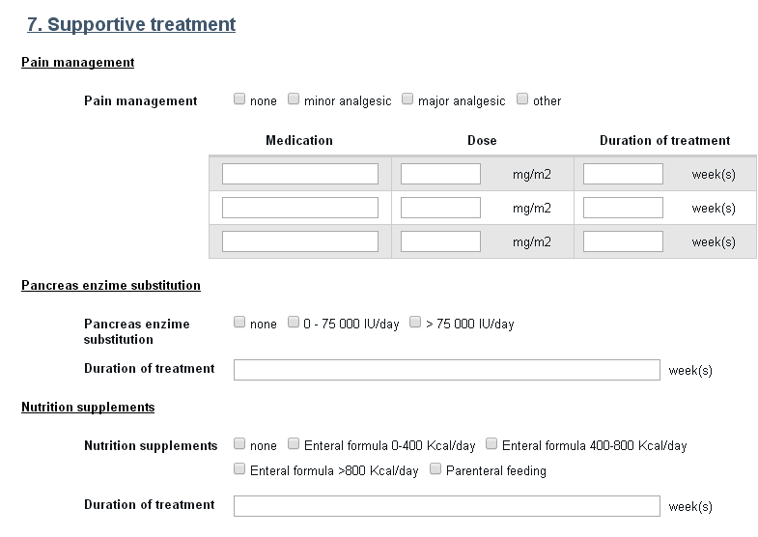
Pancreatic cancer registry
registry for pancreatic cancer - Content
7. Supportive treatment
Pain management
Pancreas enzime substitution
Nutritional supplements
Hungarian Pancreatic Study Group – Magyar Hasnyálmirigy Munkacsoport

Slide 16
Pancreatic cancer registry
Mandatory data
Mandatory data:
Personal data
- Name
Date of birth
Gender
Date of diagnosis
Clinical stage – resectability
Histological diagnosis is not mandatory
Hungarian Pancreatic Study Group – Magyar Hasnyálmirigy Munkacsoport

Slide 17
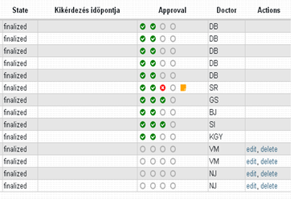
Pancreatic cancer registry
Data control
Submitted data need to be approved.
Two independent data manager
will monitor the data
Inpossible to check all data
Possibility to ask for source
documentation
Hungarian Pancreatic Study Group – Magyar Hasnyálmirigy Munkacsoport

Slide 18
Pancreatic cancer registry
Conclusions
Increasing incidence and mortality of PC in Central Europe
Aim: to prospectively collect and analyze data of pancreatic cancer
2015 – the registry for pancreatic cancer has been completely renewed
The registry is available in Hungarian and English
International data collection
Hungarian Pancreatic Study Group – Magyar Hasnyálmirigy Munkacsoport

Slide 19
4th Conference of the Hungarian & 2nd Conference of the Eastern and Central European
Pancreatic Study Groups
PANCREATIC CANCER (PC) registry
Thank you for
your attention!
THE HUNGARIAN PANCREATIC STUDY GROUP
IS COMMITTED TO IMPROVING
THE LIFES OF PATIENTS SUFFERING FROM
PANCREATIC DISEASES!
www.pancreas.hu
Hungarian Pancreatic Study Group – Magyar Hasnyálmirigy Munkacsoport

